Slide 1

BLOCKCHAIN TECHNOLOGY
PPT DONE BY:
MANOJ, ALAN, SANJITH, RAVI

Slide 2
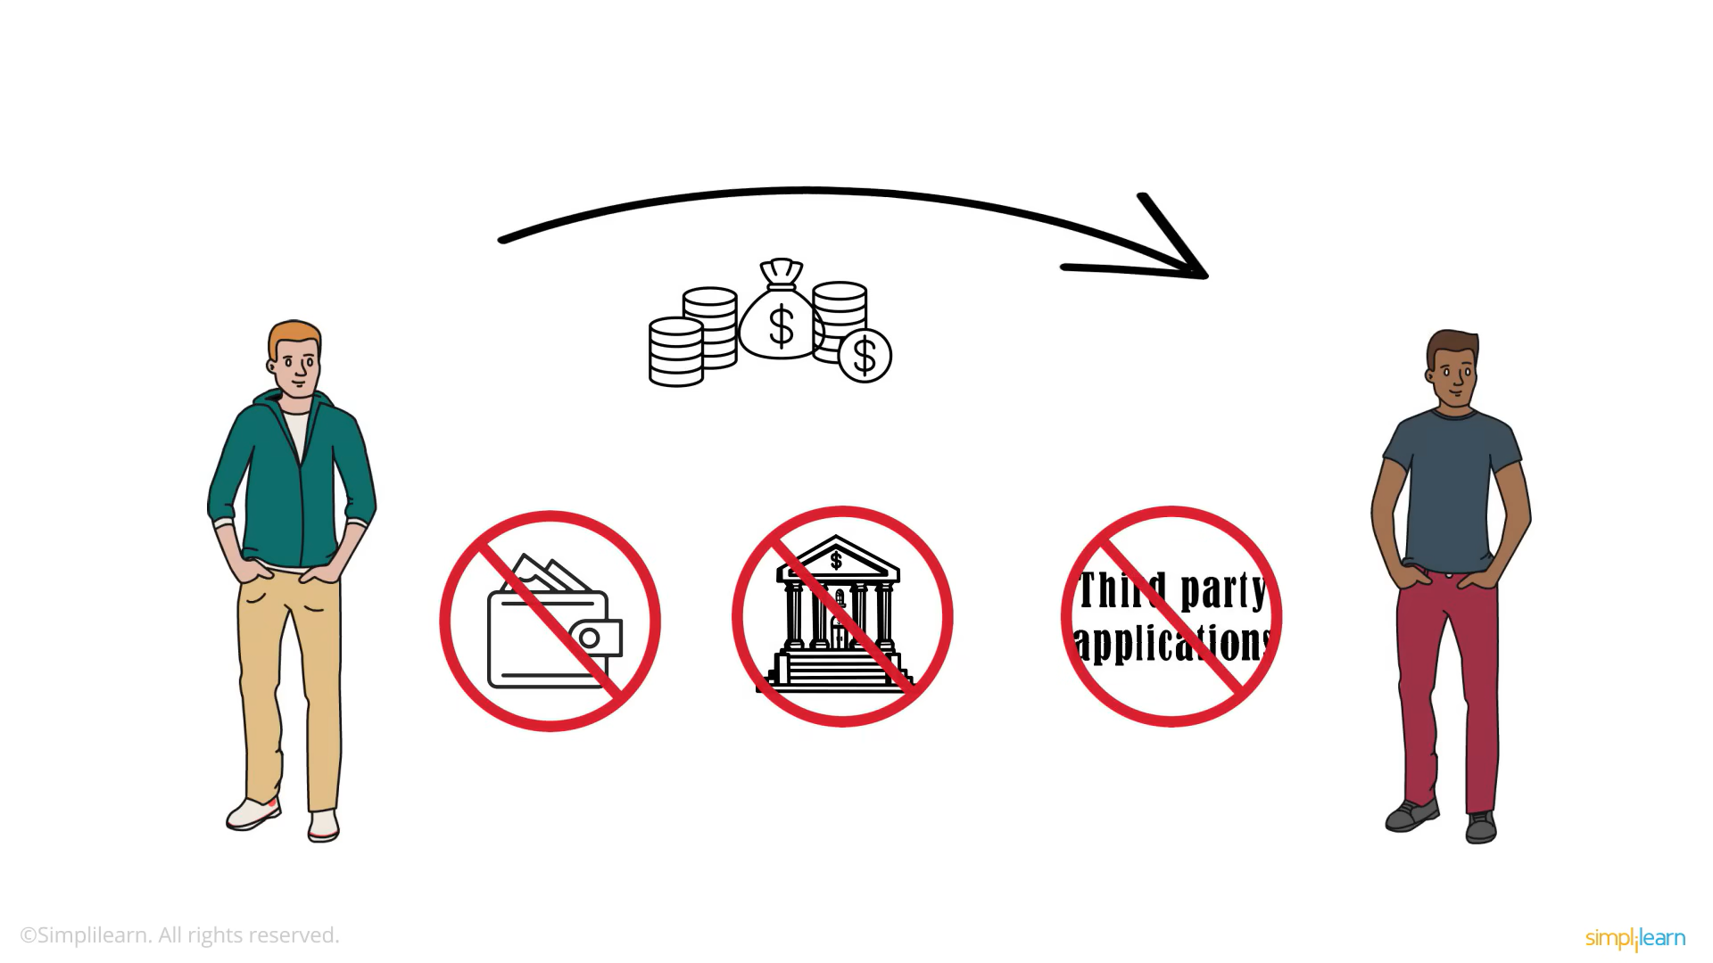

Slide 3
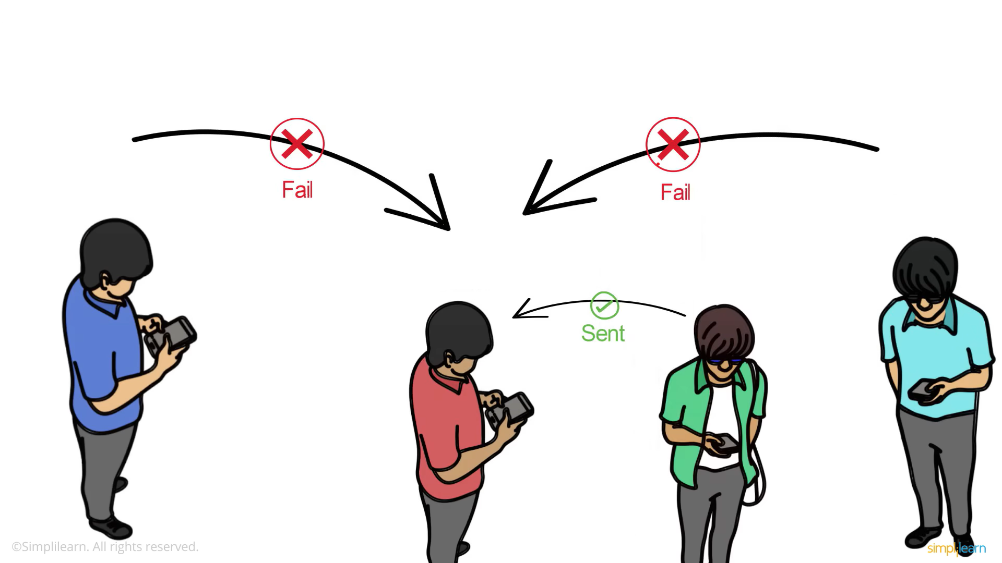
ALAN
RAVI
MANOJ
SANJI

Slide 4
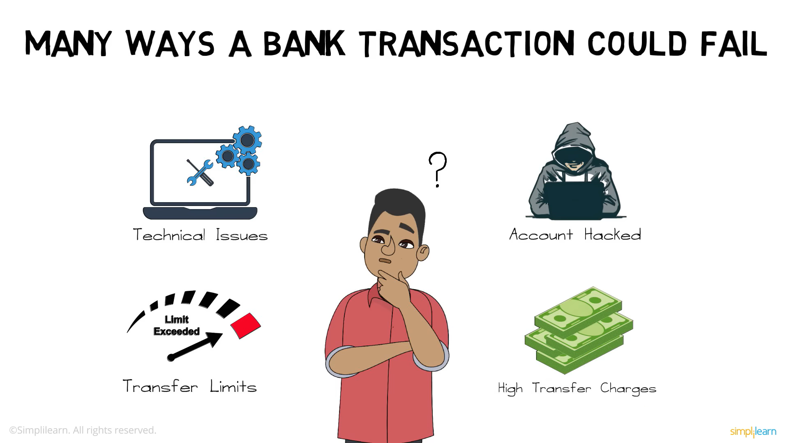

Slide 5

Then the crypto currency are formed for easy transaction
Cryptocurrency is a digital currency secured by cryptography, enabling secure, decentralized transactions. It operates on blockchain technology—a distributed ledger system maintained by a network of computers.
There are many types of crypto currency:
Popular Examples:
Bitcoin (BTC): The first cryptocurrency, introduced in 2009.
Ethereum (ETH): Supports smart contracts and decentralized apps.

Slide 6
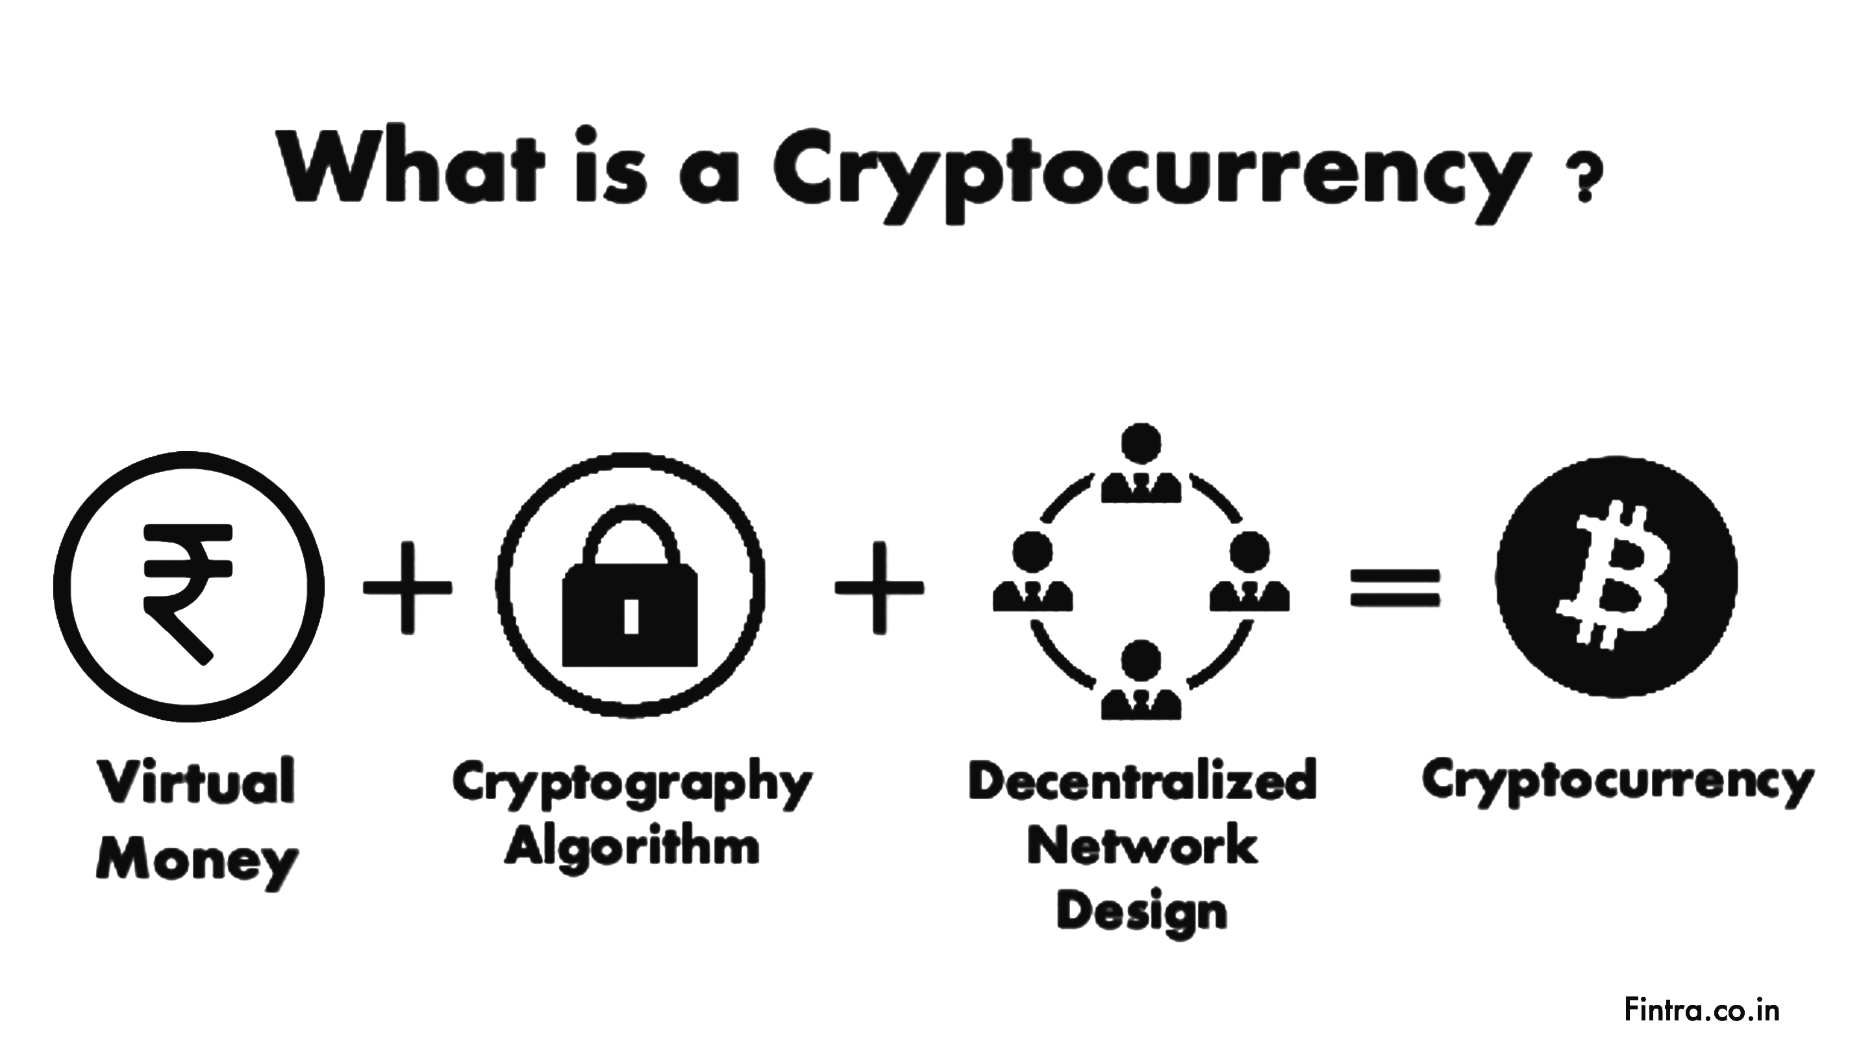

Slide 7
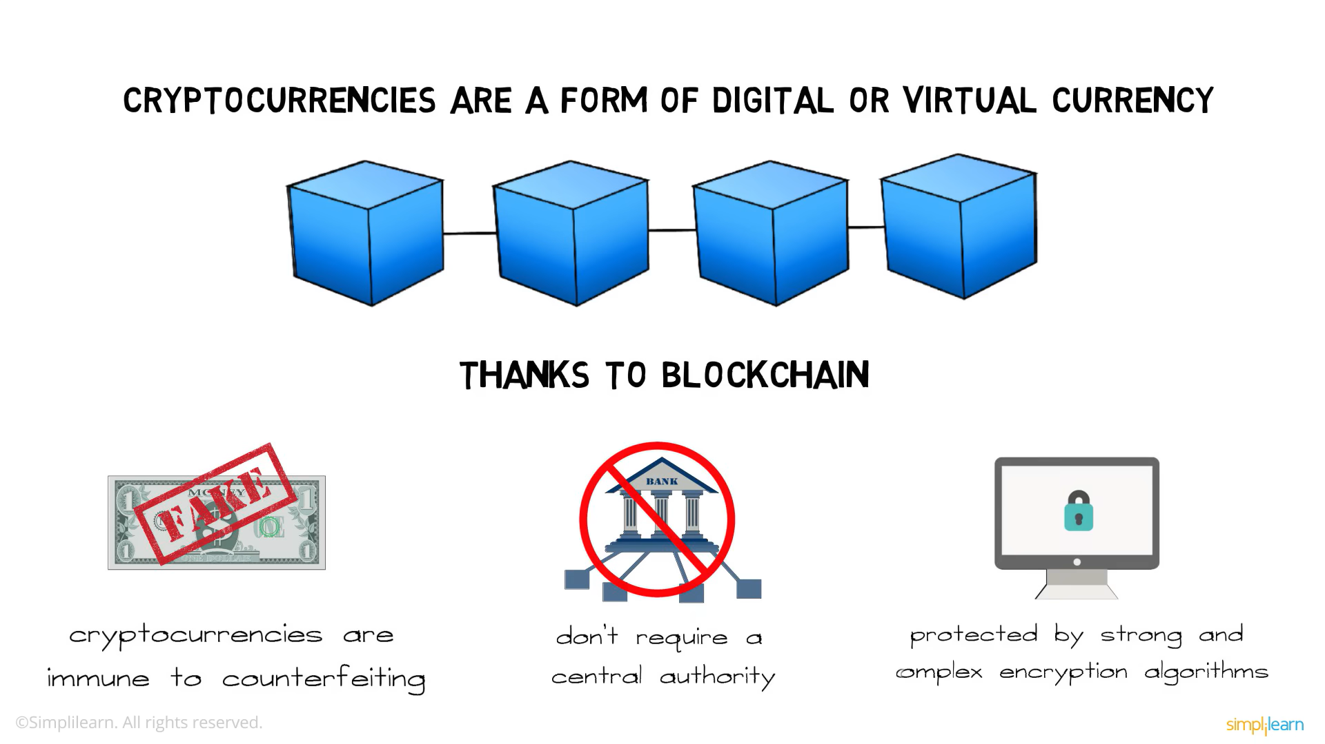

Slide 8
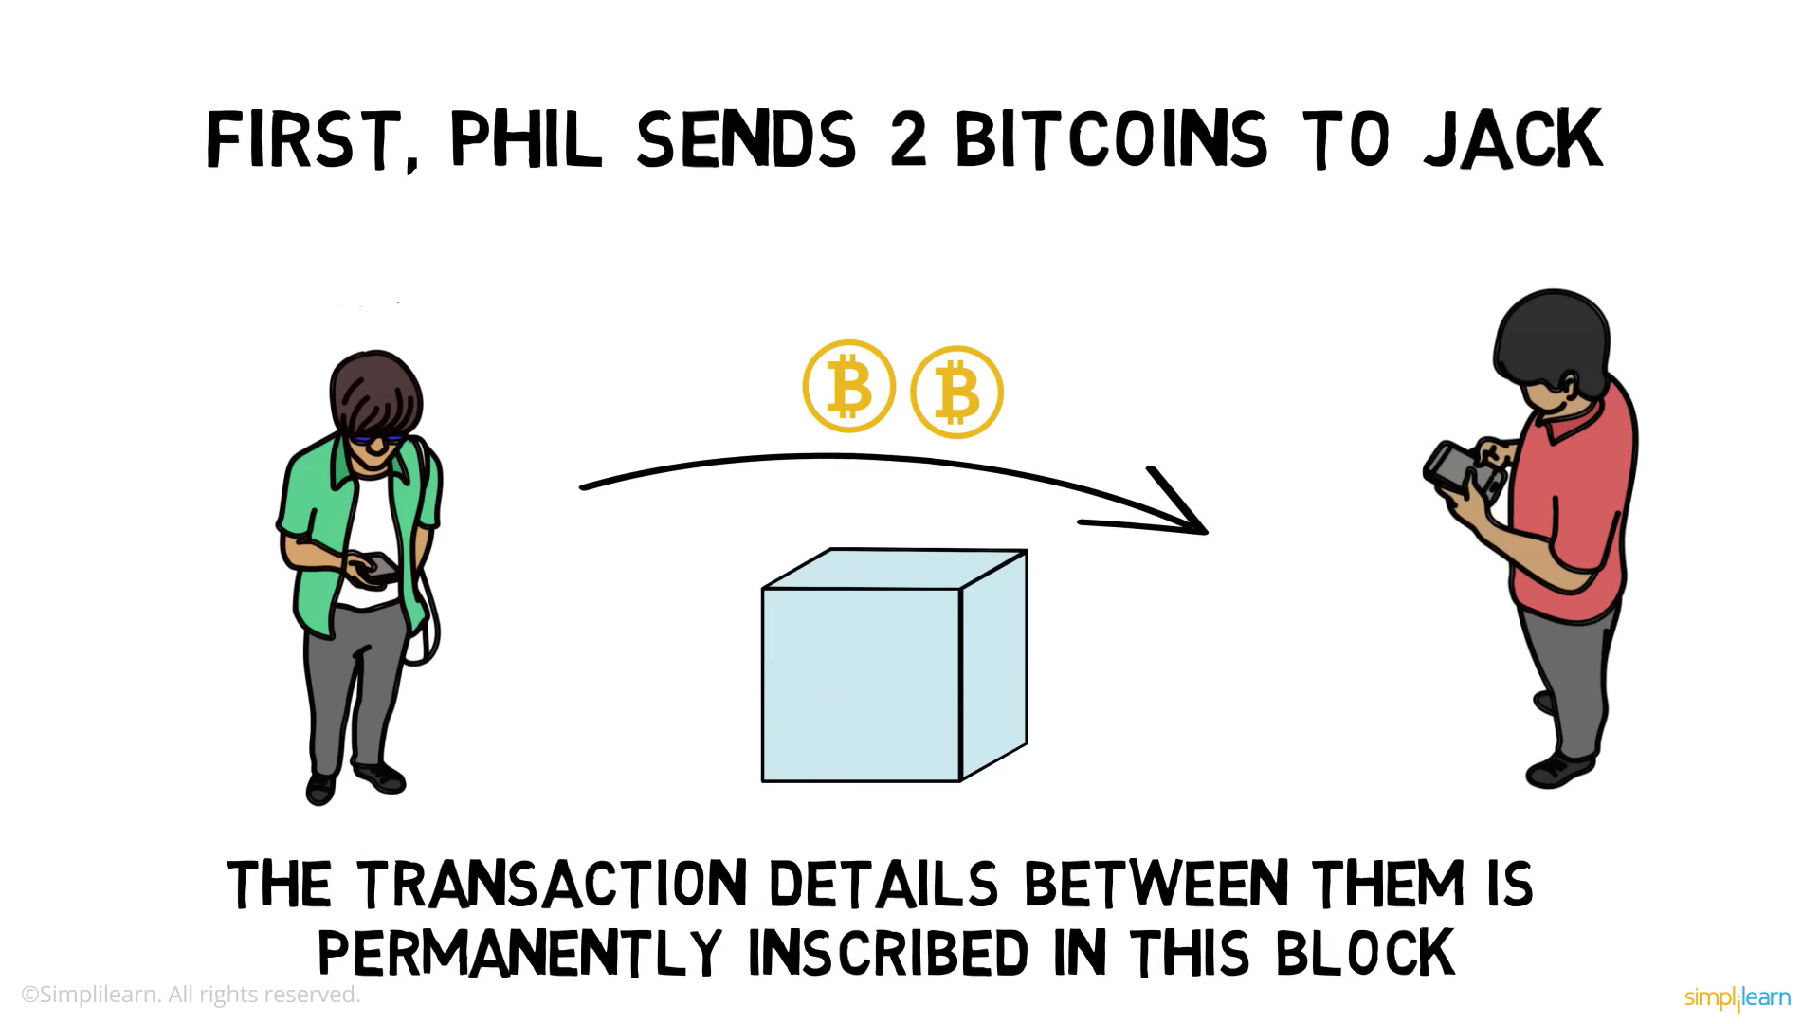



How does Blockchain works?
MANOJ
SANJI
SANJ -> 2BTCJACK

Slide 9
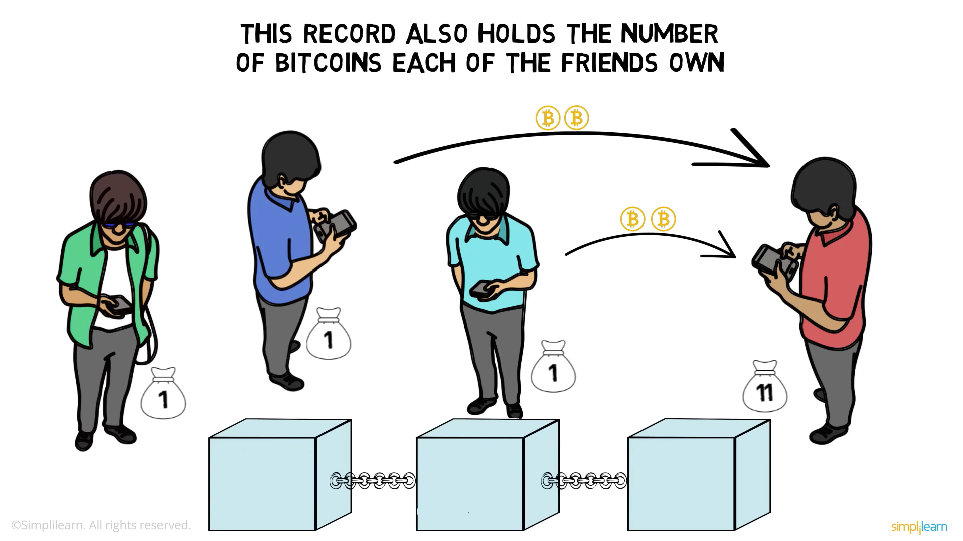
ALAN
SANJI
MANOJ
RAVI
SANJ-> 2BTCMANOJ
MANOJ:7 SANJ:1
ALAN:3 RAVI:3
ALAN-> 2BTCMANOJ
MANOJ:9 SANJ:1
ALAN:1 RAVI:3
RAVI-> 2BTCMANOJ
MANOJ:11 SANJ:1
ALAN:1 RAVI:1
→ LEDGER

Slide 10
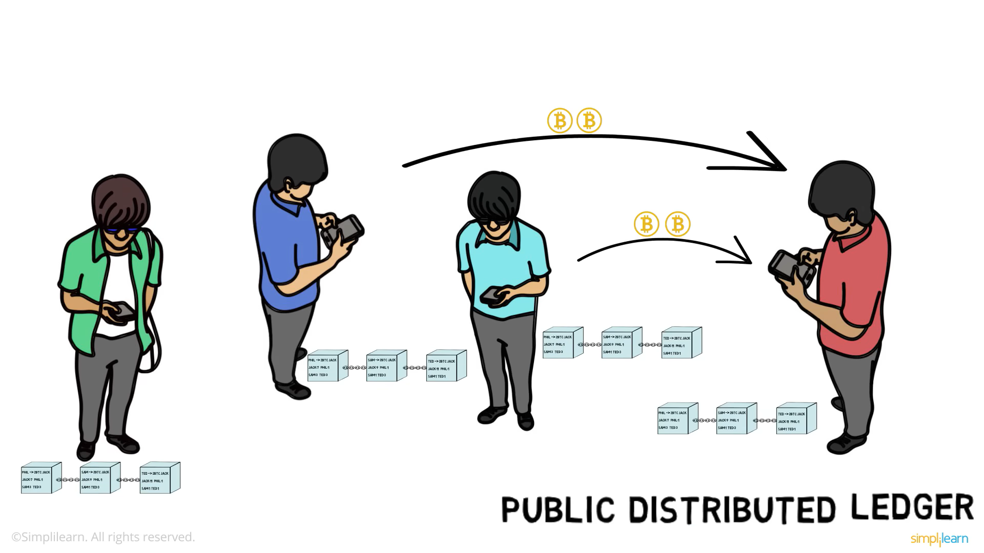

Slide 11
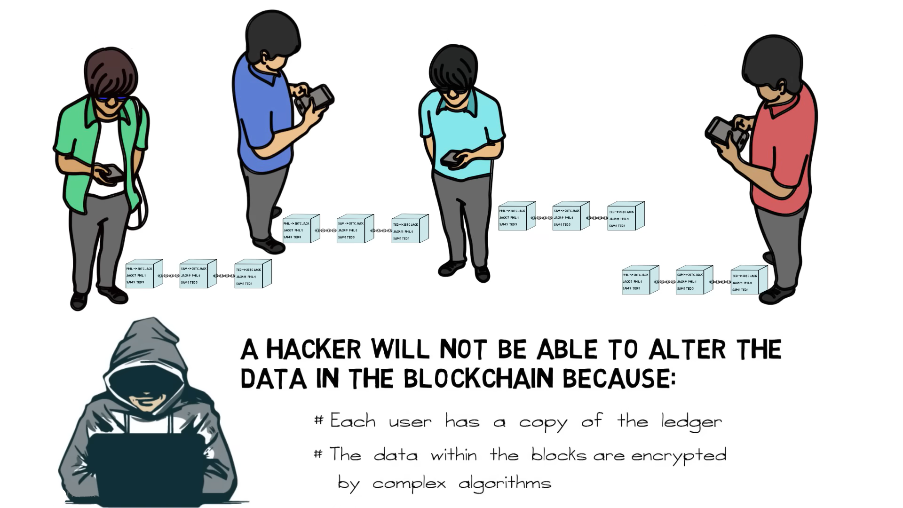
Alan
Ravi
Manoj
Sanji

Slide 12




Slide 13
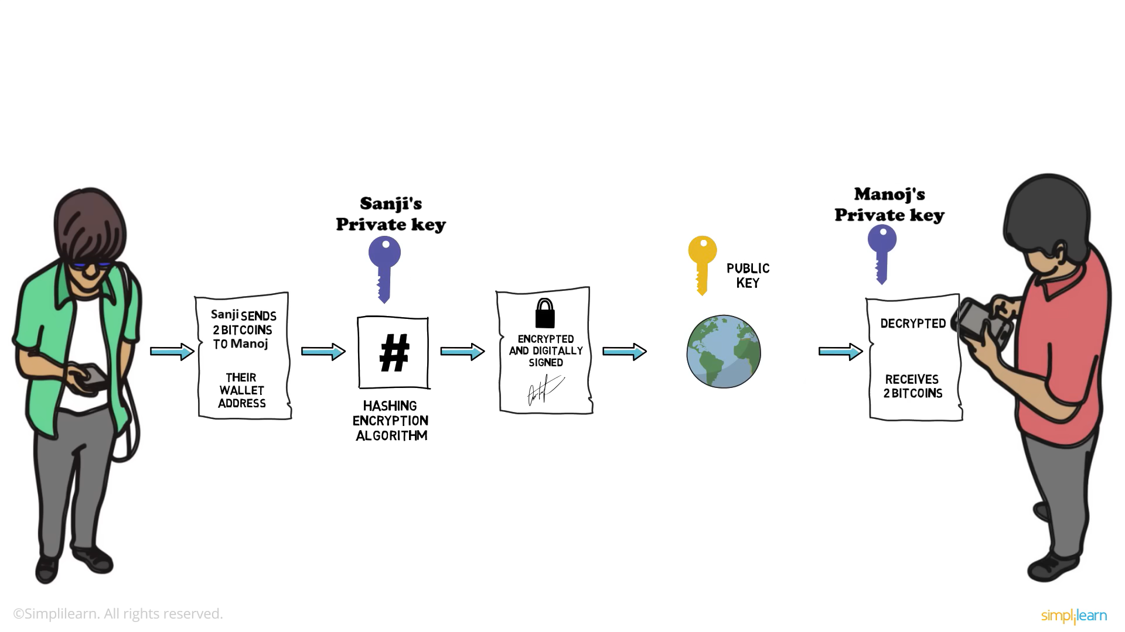

Slide 14

Different cryptocurrency use different hashing algorithms:
BITCOIN → SHA256
ETHEREUM→ETHASH
LITECOIN→SCRYPT

Slide 15
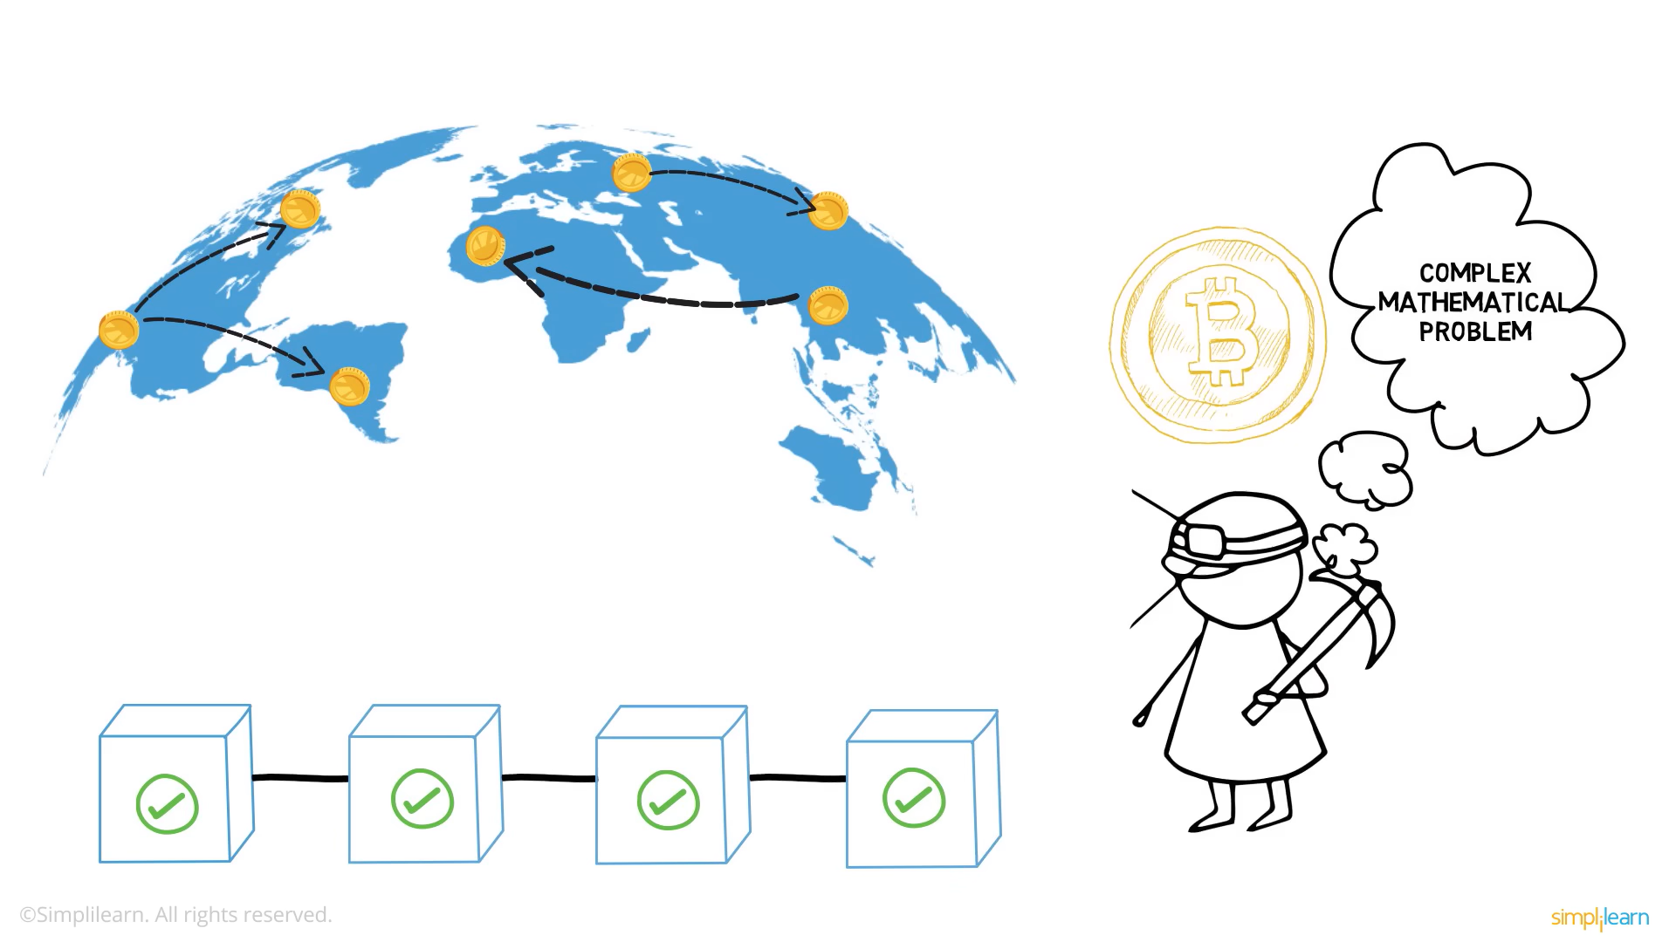

Slide 16

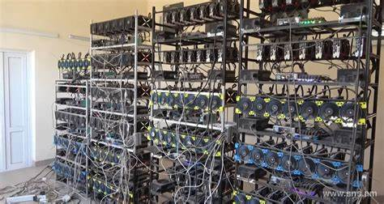
CRYPTOMINING:
Cryptocurrency mining is the process of validating and adding transactions to a blockchain network while simultaneously minting new coins. GPU (Graphics Processing Unit) mining is a popular method due to the high computational power of GPUs.
How GPU Mining Works:
Problem Solving: Miners solve complex mathematical problems (cryptographic puzzles) to validate transactions and create new blocks.
Hash Calculation: GPUs perform repetitive calculations at high speeds to find the correct cryptographic hash.
Reward System: Successful miners receive cryptocurrency rewards (e.g., Bitcoin or Ethereum).

Slide 17
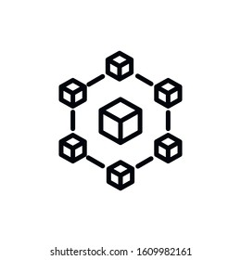
Proof of work & Mining
Proof of work:
The process of solving the complex mathematical problem is called proof of work.
Mining:
The process of adding the bitcoins to the block into blockchain is called mining.

Slide 18
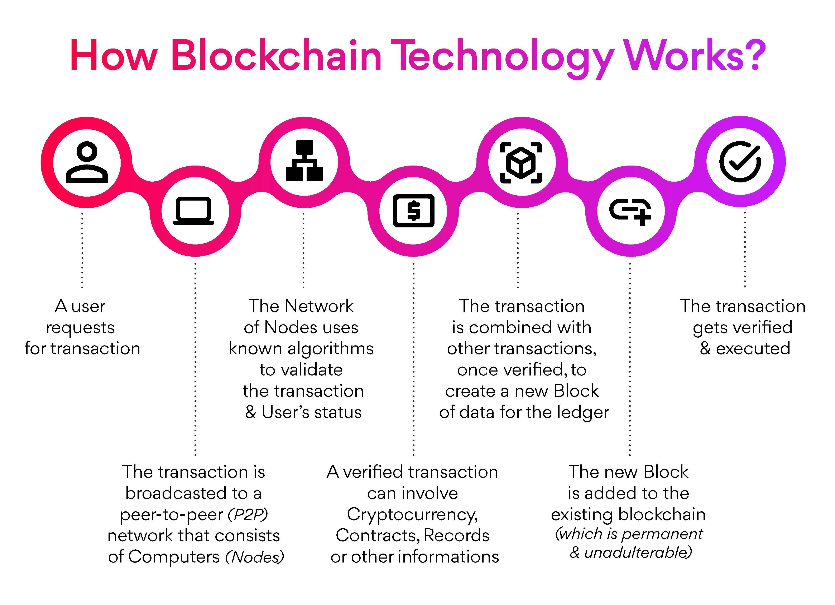

Slide 19
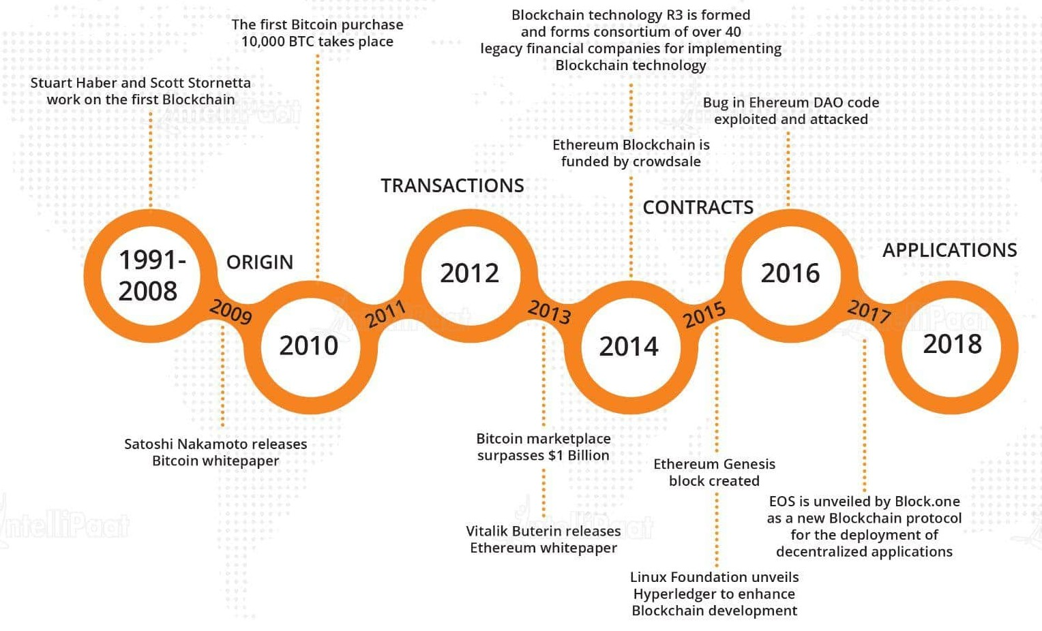
THE HISTORY OF BLOCK CHAIN:

Slide 20

THANK
YOU!

